Slide 1
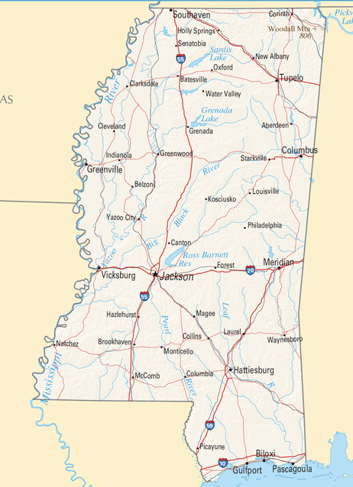
Brain Drain: Where is it? Why there? Why care?
Jay Howell, The University of Southern Mississippi
Lamont Maddox, University of North Alabama

Slide 2

Session Overview
Problem: Building Capacity for Problem-Based Geographic Inquiry (PBGI)
Explore Brain Drain Curriculum Materials & Video Case
  Consider a “transfer portal” lesson grabber
  Sample portions of a geographic investigation
  Watch implementation video & commentary
III. Reflect on PBGI Lesson Materials

Slide 3

Project Context
3-yr. Lesson Study Project funded by NCGE
Successfully built PBGI curriculum materials (scaffolded)
Implementation was less consistent
Need more models of problem-based learning in geography
  Video Case

Slide 4
Design Principles
Learning Should Be:
  Purposeful
  Connected
  Active & Challenging
  Supported

Slide 5
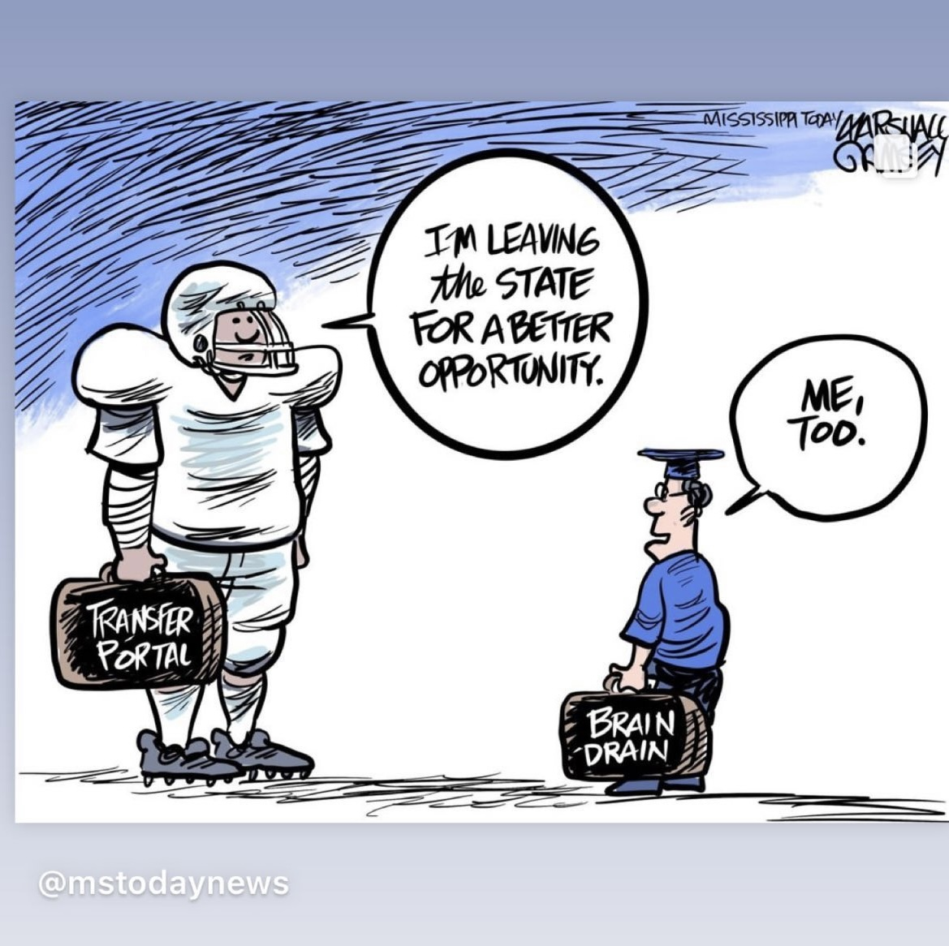
Lesson Grabber
What do you see?
Who do you see?
Is there any symbolism?
What is the message?
Notes:
Guide students to share details they notice in the cartoon. Once some of the basic features have been identified, ask students to interpret the meaning of terms and symbols in the cartoon.
Ask a student to explain what they know about the “transfer portal” written on the football player’s suitcase. Ensure students understand that the transfer portal is essentially a list of college athletes (in this case, football players) that have decided to leave the program where they currently have a scholarship for a better opportunity (more playing time, higher pay through name, image, and likeness endorsement deals). The original program invests time and money to recruit the athlete and develop them into a quality player. This investment, however, is lost if the player decides to leave on his own. The school loses the talents of that athlete.
Ask students to also consider what is represented by the hat on the individual depicted on the right. What “better opportunity” might be pulling the student to leave the state?
Finally, ask students to draw some conclusions about the overall point or meaning behind the cartoon. They might conclude that both the school football program and state experience “drain” when a person they have invested in decides to leave.
Point out that the cartoon was drawn by Mississippi’s own Marshall Ramsey. Ask what Mr. Ramsey might be saying about Mississippi specifically.
Verify students grasp the concept of brain drain and brain gain. Guide students to think about brain drain and brain gain in the broadest sense. When anyone leaves the state, they take their talents and skills with them.

Slide 6
Mississippi Brain Drain
Persistent Issue: What actions are justified in the interest of the well-being of the state?
Unit Question: Why does Mississippi have a brain drain and what should be done about it?
Lesson Focus Question: What is the story of the Mississippi Brain Drain?
Notes:
Yesterday you will recall we discussed cases of historic migrations to and from Mississippi by different groups of people. The migrations were influenced by push/pull factors and contributed to the diverse cultural mosaic we have in Mississippi today. Each migration event can be linked to the concept of brain drain or brain gain for Mississippi (sometimes both). We are going to build off this information today in order to answer the question: What is the story of the Mississippi Brain Drain? You will be moving into small groups to complete a geographic investigation that will help you to gain a better understanding of Mississippi’s Brain Drain today. At the end of the lesson, you will individually write this story by responding to three guiding questions. As you complete the lesson, remember the unit central question: Why does Mississippi have a Drain Drain and what should be done about it? This lesson supports answering the first part of the question.

Slide 7
Geographic Investigation Overview
Navigate to https://tinyurl.com/msbraindrain or refer to your packet
The guiding questions follow a "see, think, wonder" framework
Talk through the questions on the scaffold as a group. Do NOT divide and conquer; instead, work through the data and information provided and come to your answers collaboratively via discussion.
Flip or scroll to the lesson assessment on the final page. You will synthesize your learning from all three artifact sets at the end of the investigation.

Slide 8
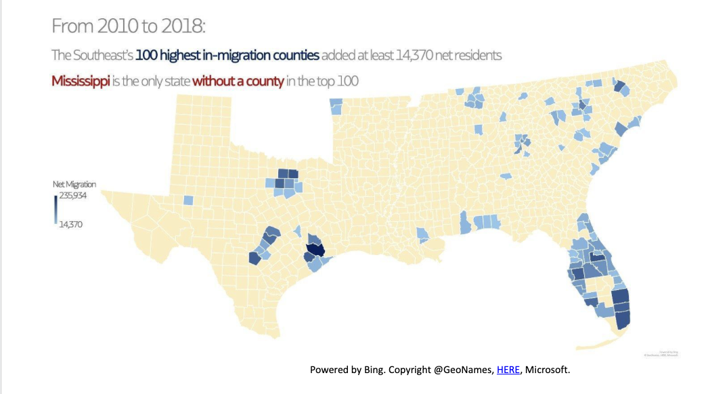
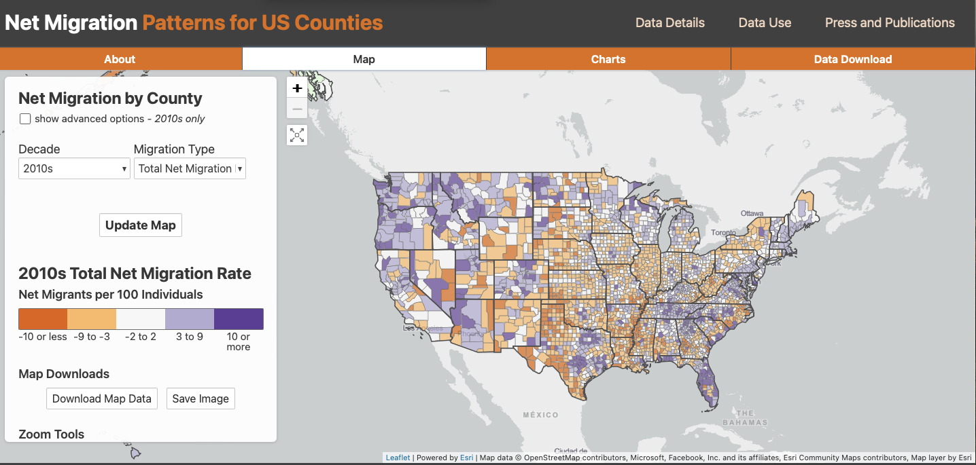
Sampling Artifact Set 1
Review the materials and work through the questions as a group.
Resource linked into "Wonder" column:
  https://netmigration.wisc.edu/

Slide 9
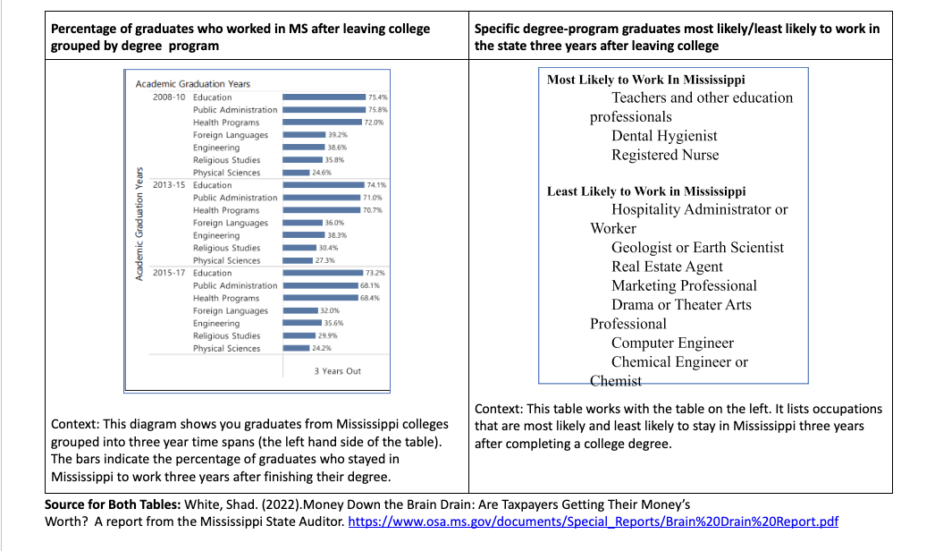
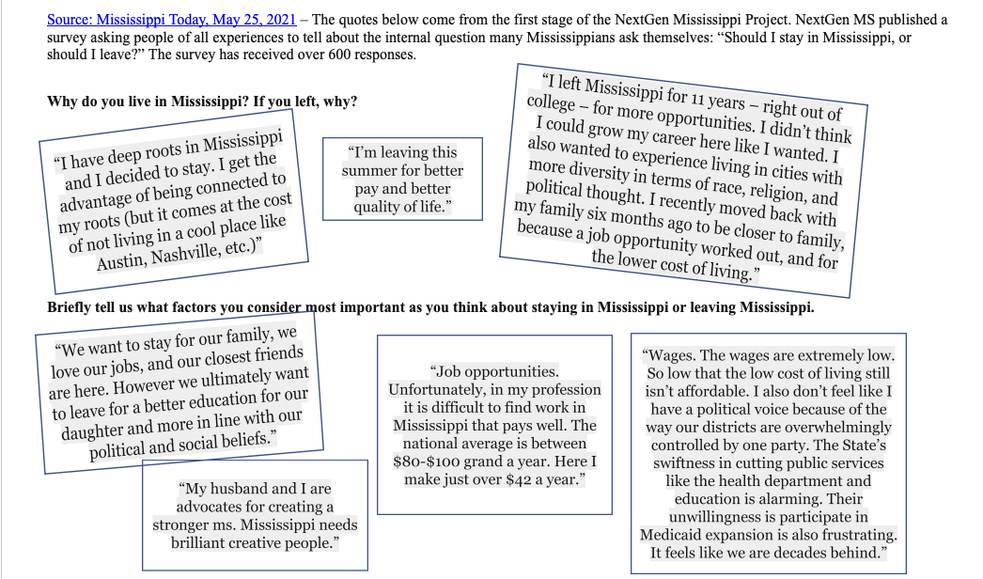
Sampling Artifact Set 2
Review the materials and work through the questions as a group.

Slide 10
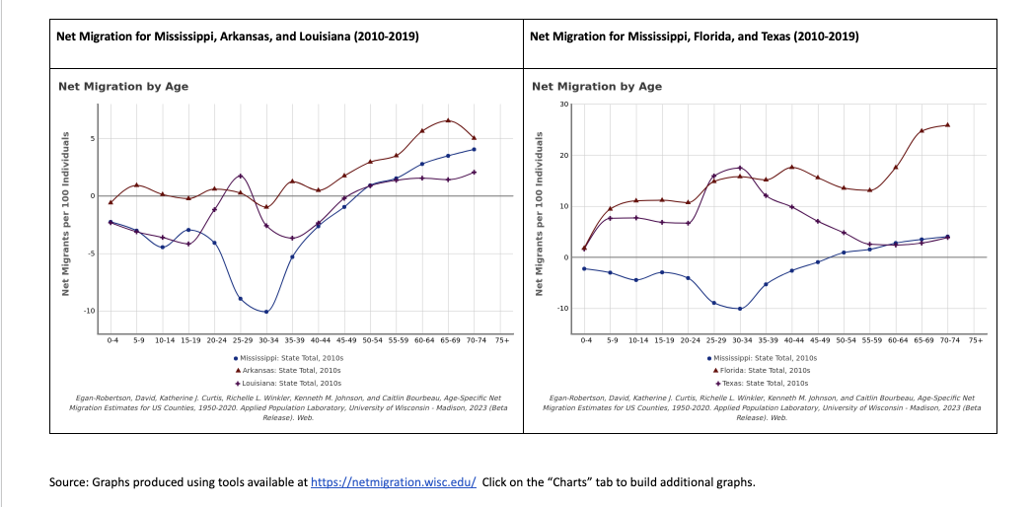
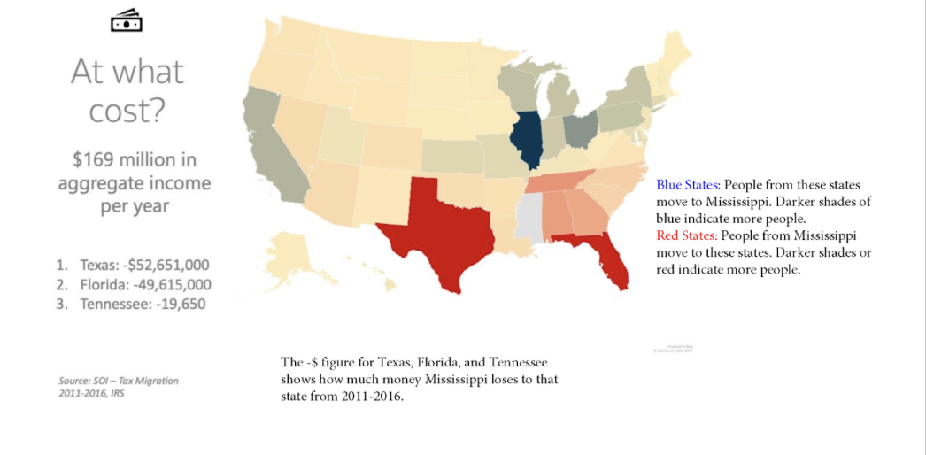
Sampling Artifact Set 3
Review the materials and work through the questions as a group.

Slide 11
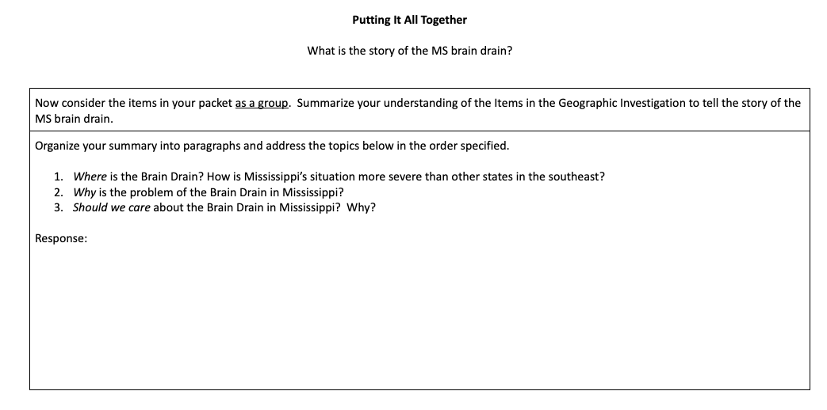

Slide 12
Video Case: Ben Austin
Sampling Authentic Classroom Experiences

Slide 13
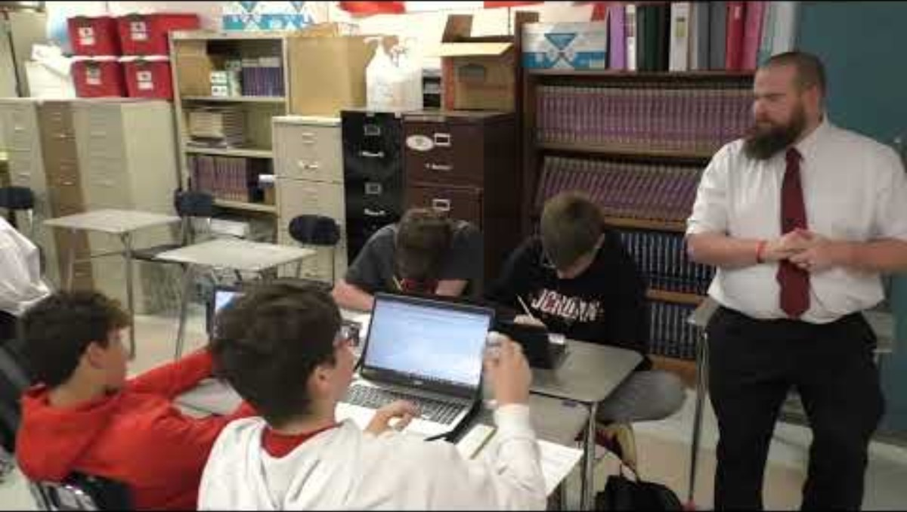
Notes:
Instruction Clip

Slide 14
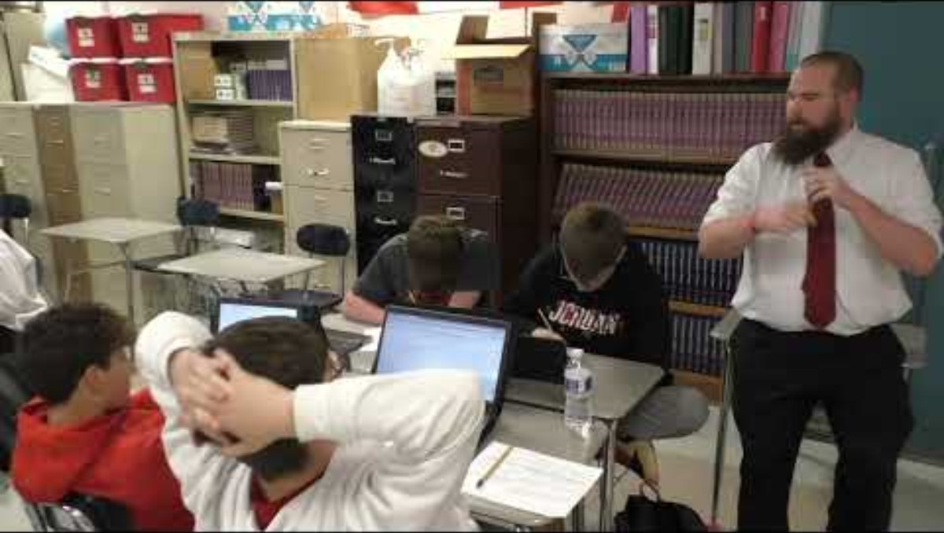
Notes:
Teacher Commentary Clip 6

Slide 15

Reflection

Slide 16


Slide 17


Questions?
  Jay Howell – james.b.howell@usm.edu
  Lamont Maddox – lmaddox@una.edu

